Slide 1
Weekly update 2.1
Details of 3 use cases
Paper : Application Container Security Guide

Slide 2
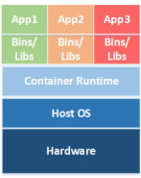
Container Architecture
Host OS
Container runtime
Images
Registry
Microservice
Orchestrator
Notes:
1. Host OS : i) General-purpose OS, ii) Container specific OS
ii) They actively 416 discourage running applications outside containers,
They often use read-only file system.
2. Gives abstraction to OS.
3. Files required to run container.
4. Helps to maintain, store, find, reuse image files.
5. Known
6. Manages different operations between containers.
6.

Slide 3
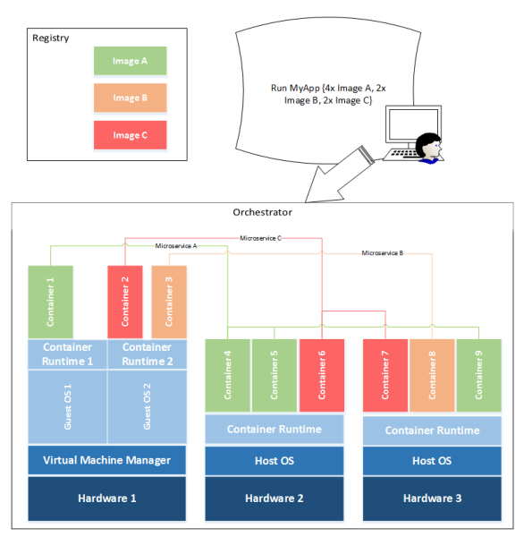
Interaction among container components

Slide 4
Host OS risks
Improper user access rights
Host component vulnerabilities
Countermeasures :
Only the specific set of access required should be provided to the specific resources required for an administrator to perform their job.
Should use tools provided by the OS vendor or other trusted organizations to regularly check for and apply updates to all software components
Notes:
1.
2.

Slide 5
Container runtime risks
Vulnerabilities within the runtime software (U.C 1, 3)
Unbounded network access from containers (U.C 1, 2)
Insecure container runtime configurations ( U.C 3)
Shared kernel (U.C 2, 3)
Countermeasures :
Carefully monitor, can use tools
Those who access internet more often should be placed at border
Mandatory access control technology provides enhanced control
Group containers by relative sensitivity
Practical attack scenario :
CVE-2017-5123 (Privilege escalation)
Attack using SSH
Symbolic link attack
ShellShock, Dirty Cow

Slide 6
Image risks
Image vulnerabilities (U.C 1)
Image configuration (U.C 1)
Embedded malware (U.C 1)
Embedded secrets (U.C 1)
Image trust (U.C 1)
Countermeasures :
Container-specific vulnerability management tools, frequent app update
Non-privileged users shouldn’t have access to images
Use tools
Sensitive data should never be stored in image files
Enforce a set of trusted images and registries
Practical attack scenario :
ShellShock
N/A
Trojan, Ransomware
N/A
N/A
Notes:
1. Image may often be out of date and missing critical security updates
2. A poor configuration can still expose a fully up-to-date system to attack
3. Images from base layers provided by third parties can contain malware
4. Ex: passwords kept in image files, this practice creates a security risk because anyone with access to the image file can easily parse it to learn these secrets.
5. When troubleshooting a problem with a web application, a user may find another version of that application available in an image provided by a third party. Portability and ease of reuse.

Slide 7
Registry risks
Insecure connections to registries (U.C 1)
Stale images in registries (U.C 1)
Countermeasures :
Ensure that all data pulled from a registry is encrypted in transit between the registry and the destination.
i) Prune registries of unsafe, vulnerable images that should no longer be used(automated) ii) Operational practices should emphasize accessing images using immutable names that specify discrete versions of images to be used
Notes:
1. Images should not include secrets or user data, if connections to registries are performed over insecure channels, the contents of images are subject to the same confidentiality risks as any other data transmitted.
2. Images can include many vulnerable, out-of-date versions.

Slide 8
Orchestrator risks
Unbounded administrative access (U.C 2)
Weak or unmanaged credentials ( U.C 1)
Unmanaged inter-container network traffic (U.C 2)
Mixing of workload sensitivity levels (U.C 2)
Countermeasures :
Ex : Test team members should have limited or no access to containers used in production
Use strong authentication credentials, and centralize auditing of access, making anomaly detection more effective
Virtual overlay network security should be ensured
Orchestrators should be configured to isolate deployments to specific sets of hosts by sensitivity levels
Practical attack scenario :
N/A
N/A
ARP spoofing, MAC flooding
Notes:
1.
2.
3. Traffic between individual nodes is routed over a virtual overlay network
4. Workloads of differing sensitivity levels on the same host
4. afficc between individual nodes is routed over a virtual overlay network between individual nodes is routed over a virtual overlay network

Slide 9
Attacks
ShellShock: This is a security bug. It enables an attacker to cause to bash to execute arbitrary command.
Remote access attack via SSH(Secure Socket Shell): It enables remote access. It is a network protocol that gives users specially system administrator, a secure way to access a computer over an unsecured network
Privilege escalation: When an attacker logs into the host system using an account with elevated access privileges.

Slide 10
Attacks cntd…
SlowLoris: Slow http DoS attack. This attack exploits the fact that Apache wait for complete http headers to be received before closing a http connection. An attacker can send multiple incomplete GET request to keep the connections open in order to block other users from getting their request processed by the server.
Syn Flood: It may happen during 3-way handshake in TCP connection establishment phase. Attacker will send tons of SYN packets.
ICMP flood or Ping flood attack: Attacker attempts to overwhelm a targeted device with ICMP echo request.

Slide 11
Attacks cntd…
Dirty COW: COW means copy on write. Because of the race condition(in linux kernel memory subsystem), with the right timing a local attacker can exploit the COW mechanism to turn a read only mapping of a file in a writable mapping.(Details:Dirty Cow (toronto.edu))
Controlled Channel Attack: Page tables in processors are handled by OS. When a page fault occurs, the MMU(Memory management unit) then reveals the required page to the OS for the page fault handler to handle page fault. Now if the OS is malicious it can obtain valuable informations from here.

Slide 12
Attacks cntd…
Heartbleed Bug: This is a bug in OpenSSL cryptographic software library. It results from improper input validation in the implementation of TLS heartbeat extension. It causes buffer Overread(more data can be read than should be read.)
Forkbomb Attack(Rabbit Attack): In this attack, fork system is recursively used until all system resources execute a command. During this attack, keyboard inputs are ignored and creates kernel panic
MAC flooding: Switch contains table of MAC address. An attacker will fed many ethernet frames containing many MAC addresses to force legitimate MAC address out of the MAC address table.

Slide 13
Roadblockers
We couldn’t find all possible practical attack scenarios for all uses cases.

